Slide 1
Neonatal Palliative Care An Opportunity for Transformation
Nikki McLaughlin, MSN, CCRN, NNP-BC
Emory University Nell Hodgson Woodruff School of Nursing

Slide 2
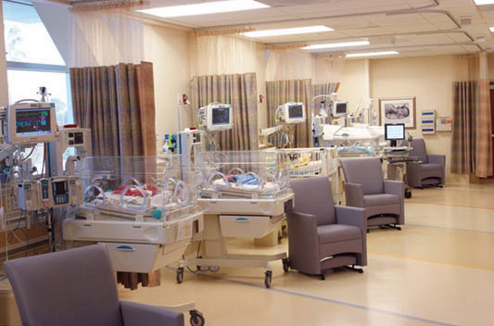
Stats & Figures
Neonatal mortality continues to decrease
Approx 16,000 neonatal deaths in 2010
Virtually all within NICU
Our NICU
~300
annual
Notes:
16,193 neonatal deaths; 4.05% mortality rate
CDC defines NICU admission as “admission into a facility or unit staffed and equipped to provide continuous mechanical ventilator support for the newborn.” This definition approximates the American Academy of Pediatrics designation of a level III or IV nursery

Slide 3
What should we aim for?
Comprehensive Palliative Care Protocol
Case Management
Staff & Family Support
Symptom Management
Memory Making
Notes:
Endorsement from NANN

Slide 4
Barriers to Success
Moral Distress
Historical Practices
Negative Perception
Staff Training and Education
Physical Limitations
Family Demands
Notes:
Any path is not without its challenges. Historically and in literature these exist

Slide 5
The Fix? -Interdisciplinary Collaboration
Neonatal Palliative Care Team
Bedside Pioneers
Leadership Influence
Taking Notes
Nurse Management
Practitioners
Physicians
Unit and Division Directors
Clinical Nurses
Emory Palliative Care Team
CHOA Pediatric Palliative Care

Slide 7
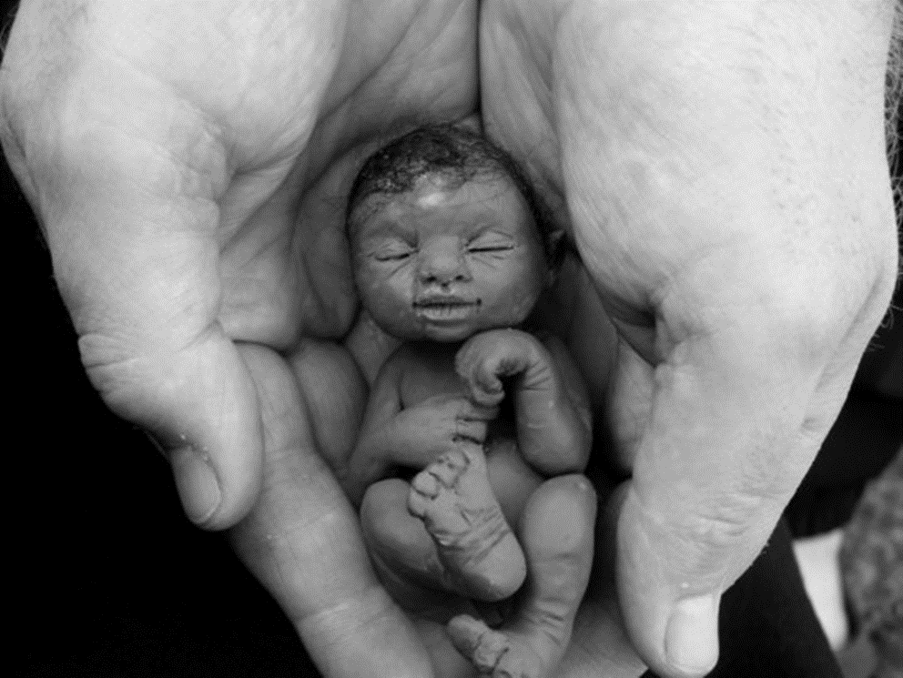
Thank You
Notes:
I implore you to see the need for a neonatal palliative care team and standardized protocols in our unit. Our sickest babies and their families deserve compassionate, comprehensive attention for the entirety of their time in our care.

