Slide 1
Intestinal Obstruction in the Neonate
Nikki McLaughiln, BSN, CCRN
East Carolina College of Nursing

Slide 2
Maternal History
22 y.o. now Gravida 3 Para 3
Blood Type A+
HepB negative
Rubella immune
Syphilis nonreactive
HIV negative
GBS negative
Pregnancy Complications: UTI
Significant Maternal Conditions: None

Slide 3
Delivery History
Estimated 40 week, male infant
Delivered vaginally, spontaneous
Clear amniotic fluid
Resuscitation per NRP guidelines
Apgar scores of 9 and 9
Birthweight of 3.720kg

Slide 4
Origins of Intestinal Obstruction
Differential Diagnoses
Ileal Atresia
Malrotation w/ or w/o Volvulus
Hirschsprung’s Disease
Meconium Ileus

Slide 5
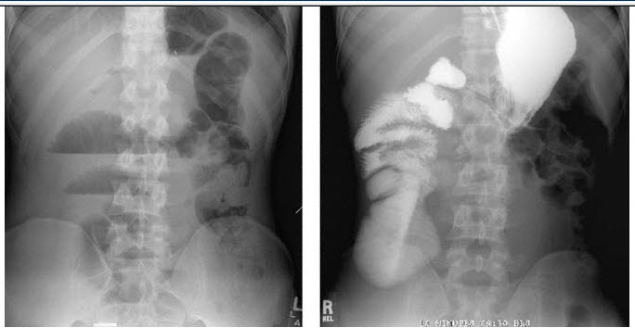
Admission Assessment
Abdominal X-Ray
Screening CBC
Upper GI
Rectal Temperature

Slide 6
Malrotation Physiology and Pathophysiology
Embryology
Incidence of 1 in 500 live births
Associated with intestinal atresia, CDH, duodenal obstruction, omphalocele, and gastroschisis

Slide 7
Surgical Correction
Exploratory Laparotomy
Ladd’s Procedure
Appendectomy
Small Bowel Resection
Ileostomy and Mucus Fistula
Rectal Biopsy

Slide 8
Post Operative Care
IV Fluids
NPO
Replogle to suction
Pain management
IV antibiotics
May need anti-reflux medication

Slide 9
Alternative Therapies
There are NO alternatives to surgical correction.

Slide 10
Complications and Comorbidities
Adhesions
Feeding Intolerance
Recurrent volvulus
Short Gut Syndrome
Death

Slide 11
Providing Family Centered Care

Slide 12
Discharge and Follow Up
Appropriate newborn screenings
Follow up with pediatrician to ensure adequate growth and nourishment

Slide 13
References
Bradshaw, W. T. (2010). Gastrointestinal Disorders. In M. T. Verklan, & M. Walden (Eds.), Core Curriculum for Neonatal intensive Care Nursing (pp. 589-637). St. Louis, MO: Saunders Elsevier.
Lovvorn, H. N., Glenn, J. B., Pacetti, A. S., & Carter, B. S. (2011). Neonatal Surgery. In S. L. Gardner, B. S. Carter, M. Enzman-Hines, & J. A. Hernandez (Eds.), Merenstein & Gardner’s Handbook of Neonatal Intensive Care (pp. 812-848). St. Louis, MO: Mosby Elsevier.
Macharia, E., & Huddart, S. N. (2010). Neonatal abdominal conditions: A review of current practice and emerging trends. Paediatrics and Child Health, 20(5), 207-214.
Stanfill, A. B., Pearl, R. H., Kalvakuri, K., Wallace, L. J., & Vegunta, R. K. (2010). Laparoscopic Ladd’s procedure: Treatment of choice for midgut malrotation in infants and children. Journal of Laparoendoscopic & Advanced Surgical Techniques, 20(4), 369-372. doi: 10.1089/lap.2009.0118
Vinocur, D. N., Lee, E. Y., & Eisenberg, R. L. (2012). Neonatal intestinal obstruction. American Journal of Roentgenology, 198, 1-10. doi: 10.2214/AJR.11.6931
All images obtained from Google Images

Slide 14
THE END

