Slide 1
Government Entitlements
Nikki McLaughlin, MSN, NNP-BC
September 27, 2015

Slide 2
What are government entitlements?
How is Social Security funded? What are the challenges facing the program?
Why Medicaid is on everyone's mind?
Entitlements
Who’s In
Social Security
Medicare
Medicaid
What programs are considered entitled?
What is Medicare? How is it funded and is it broken?

Slide 3
Government Entitlements
“An entitlement program is a type of “government program that provides individuals with personal financial benefits (or sometimes special government-provided goods or services) to which an indefinite (but usually rather large) number of potential beneficiaries have a legal right” (Johnson, 2005)

Slide 4
Included Programs
Social Security
Welfare
Medicare
Unemployment
Medicaid
Food Stamps

Slide 5
Social Security
“We can never insure one hundred percent of the population against one hundred percent of the hazards and vicissitudes of life...we have tried to frame a law which will give some measure of protection to the average citizen and to his family against the loss of a job and against poverty-ridden old age.” Franklin D. Roosevelt

Slide 6
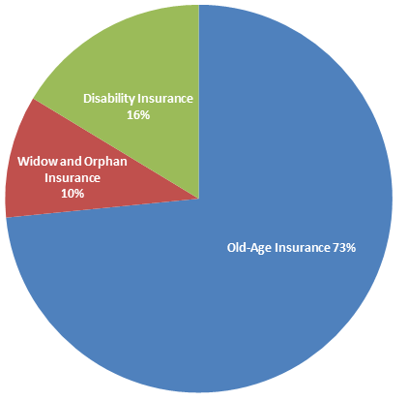
Social Security
59 Million Americans
Facts & Stats
$848.5 billion

Slide 7
How is it funded?
FICA taxes!

Slide 8
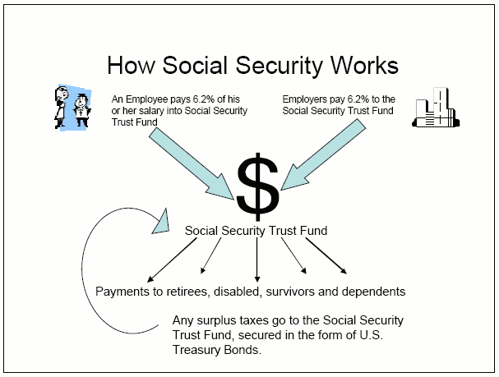
How does it all work?

Slide 9
Are we in trouble?
Ummm………

Slide 10
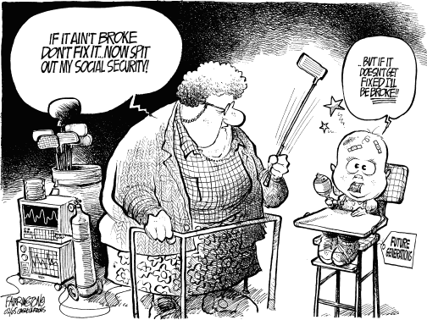
Can it be fixed?
Changes to cost-of-living
Raising eligibility age
Changes to taxation

Slide 11
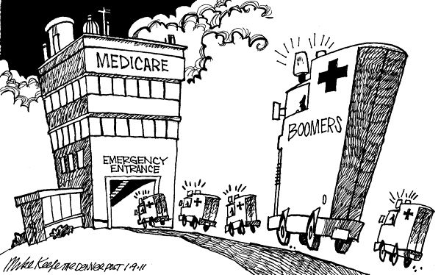
Medicare
“I believe the most important aspect of Medicare is not the structure of the program but the guarantee to all Americans that they will have high quality health care when they get older” Ron Wyden

Slide 12
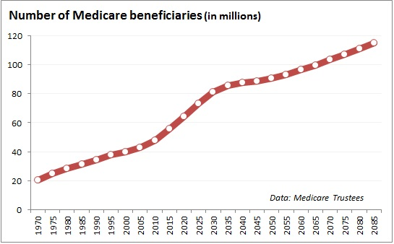
Medicare
55 million Americans
Facts & Stats
$597 billion

Slide 13
How is it funded?
FICA taxes!
...among others

Slide 14
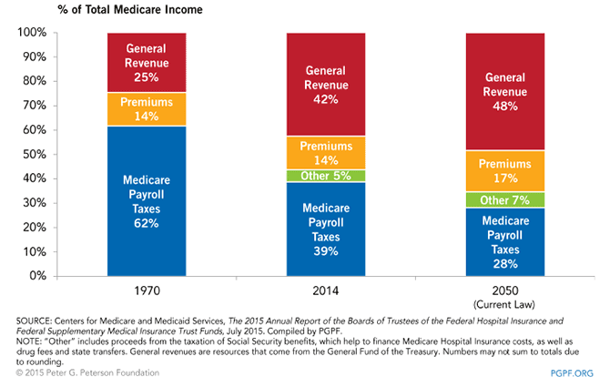
How does it all work?

Slide 15
Are we in trouble?
Ummm………

Slide 16
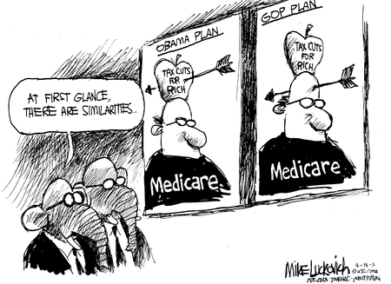
Can it be fixed?
Increasing Premiums
Raising eligibility age
Go private

Slide 17
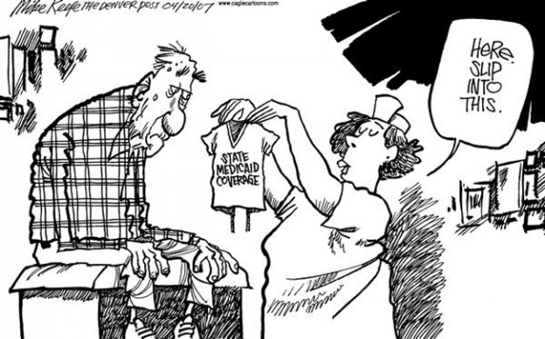
Medicaid
“At a time of economic recession, the need for Medicaid and other safety net services is even greater” James Douglas

Slide 18
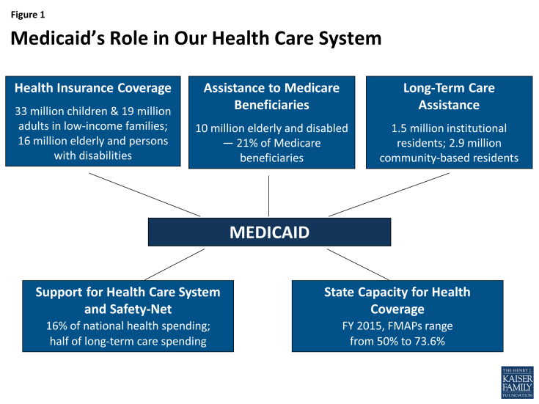
Medicaid
80 million Americans
Facts & Stats
$458.6 billion

Slide 19
How is it funded?
NOT FICA taxes

Slide 20
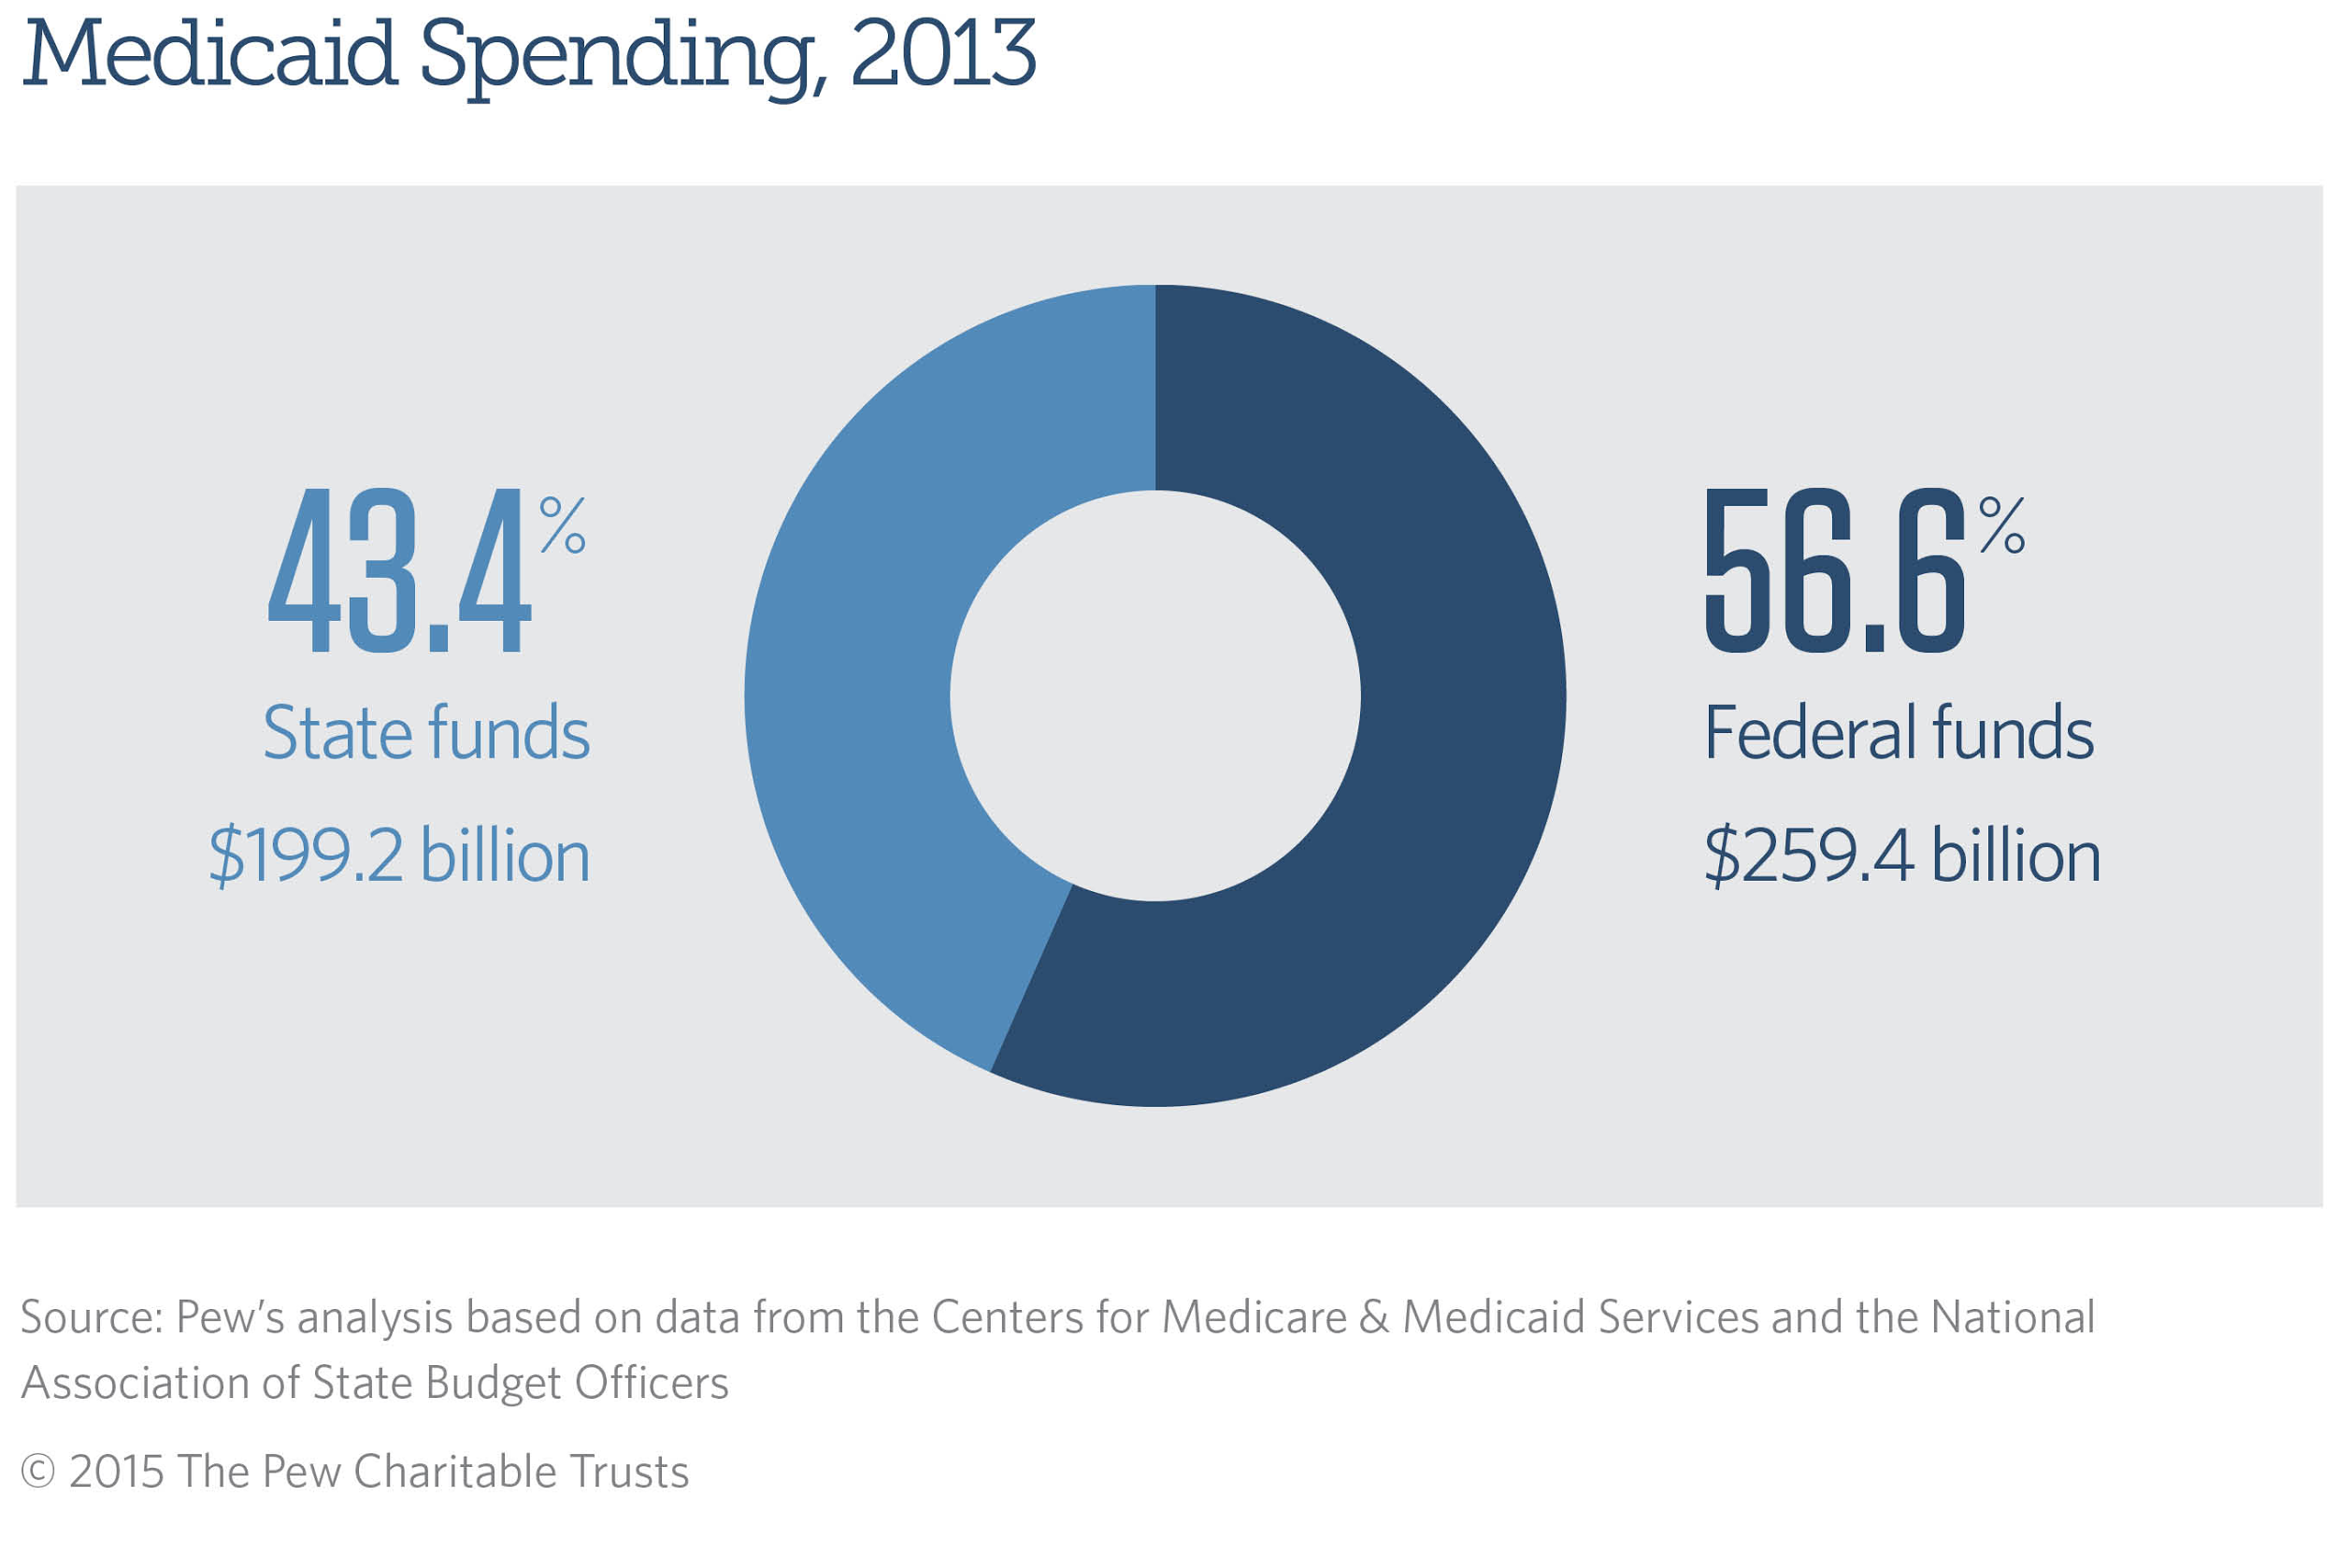
How does it all work?

Slide 21
Are we in trouble?
Ummm……

Slide 22
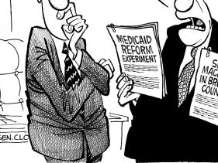
Can it be fixed?
Uniform
Eligibility
Standardized Benefits
Improved Physician Payment

Slide 23
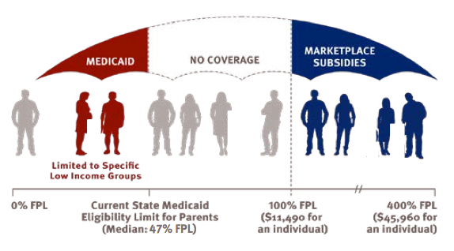
Medicaid Expansion

Slide 24
Fin

Slide 25
References
How is Medicare funded? (2015). Retrieved from: www.medicare.gov
Desilver, D. (2015). 5 facts about Social Security. Pew Research Center, 1-5
Koba, M. (2011). Medicare and Medicaid: CNBC explains. Retrieved from: http://cnbc.com/id/43992654
Moscovitz, I. (2012). 5 huge myths about social security. Retrieved from: https://www.fool.com/retirement/general/2012/10/15/5
Policy basics: Introduction to Medicaid. (2015). Retrieved from: http://www.cbpp.org/research/health/policy-basics-introduction-to-medicaid
The facts on Medicare spending and financing. (2015). Retrieved from: http://kff.org/medicare/fact-sheet/mediccare-spending-and-financing-fact-sheet
The future of Social Security and you: To sustain Social Security in the future, some changes may need to be made. (2015). Retrieved from: https://www.fidelity.com/viewpoints/retirement-social-security-future

